Slide 1


BTech IV Year VII Semester Section:
BCSE0103: SOFT COMPUTING
(Artificial Neural Network)
Dr. Dilip Kumar Sharma
SM(IEEE, ACM, CSI), Fellow IETE, Fellow IE(I)
Professor- Dept. of Computer Engineering & Applications
Dean (International Relations & Academic Collaborations)
GLA University, Mathura, INDIA
Email: dilip.sharma@gla.ac.in
https://www.gla.ac.in/academics/faculty-detail/7/prof-dilip-kumar-sharma

Slide 2

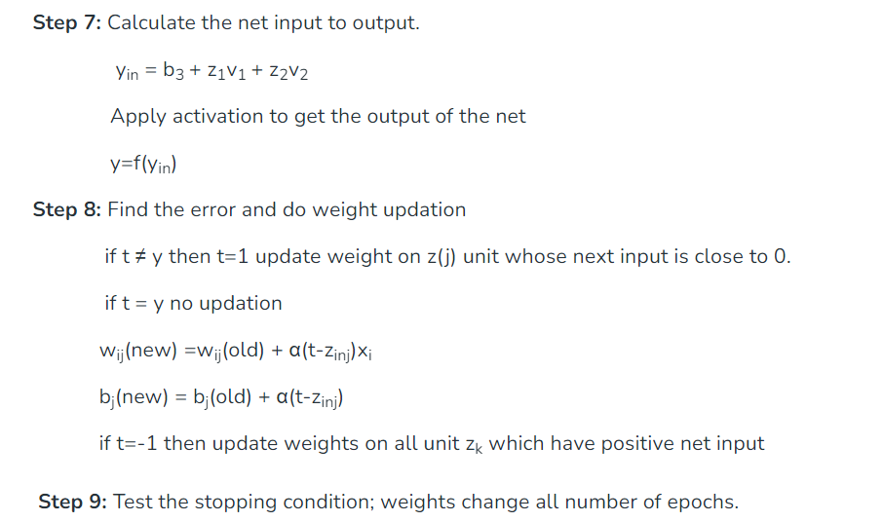
Associative Memory
Associative memory is also known as content addressable memory (CAM) or associative storage or associative array.
An associative memory network can store a set of patterns as memories. When the associative memory is being presented with a key pattern, it responds by producing one of the stored patterns, which closely resembles or relates to the key pattern.

Slide 3

Associative Memory
Training Algorithms for Pattern Association
There are two algorithms developed for training of pattern association nets.
Hebb Rule (ii) Outer Products Rule
1. Hebb Rule:
The Hebb rule is widely used for finding the weights of an associative memory neural network. The training vector pairs here are denoted as s:t. The weights are updated until there is no weight change.
Hebb Rule Algorithmic
Step 0: Set all the initial weights to zero, i.e., W_{ij} = 0 (i = 1 to n, j = 1 to m)
Step 1: For each training target input output vector pairs s:t, perform Steps 2-4.

Slide 4
Associative Memory- Hebb Rule
Step 2: Activate the input layer units to the current training input, X_{i}=S_{i} (for i = 1 to n).
Step 3: Activate the output layer units to the current target output, y_{j} = t_{j} (for j = 1 to m)
Step 4: Start the weight adjustment
Wij(new)=Wij(old)+XiYj (i=1 to n,j=1 to m)

Slide 5
Associative Memory- Hebb Rule

Slide 22
Associative Memory- Outer Products Rule
Outer products rule is a method for finding weights of an associative net.
Input=> s = (s₁, ... ,s_{i}, ... ,s_{n}) Output=> t= (t₁, ... ,t_{j}, ... ,t_{m})
The outer product of the two vectors is the product of the matrices S = s^{T} and T = t, i.e., between [n X 1] marrix and [1 x m] matrix. The transpose is to be taken for the input matrix given.
ST = s^{T}t =>
This weight matrix is same as the weight matrix obtained by Hebb rule to store the pattern association s:t. For storing a set of associations, s(p):t(p), p = 1 to P, wherein, s(p) = (s₁ (p}, ... , s_{i}(p), ... , s_{n}(p)) t(p) = (t₁ (p), · · ·' t_{j}(p), · · · 't_{m}(p))
the weight matrix W = {w_{ij}} can be given as
w=∑p=1nST(p).S(p)

